Slide 1
GAMECO
PRESENTATION
FINAL PROJECT
RACHEL H-B

Slide 2

2006-2016 SALES AND TRENDS
GameCo's sales by Region are not consistent over the past 10 years. Global sales are decreasing and 2015-2016 was an alarming drop in most markets.
Objective:
Genre impacts total Regional Sales and specifically targeting sales and development in each region by genre will grow sales in each region. Shifting the focus off poorly platforms may help save resources.

Slide 3

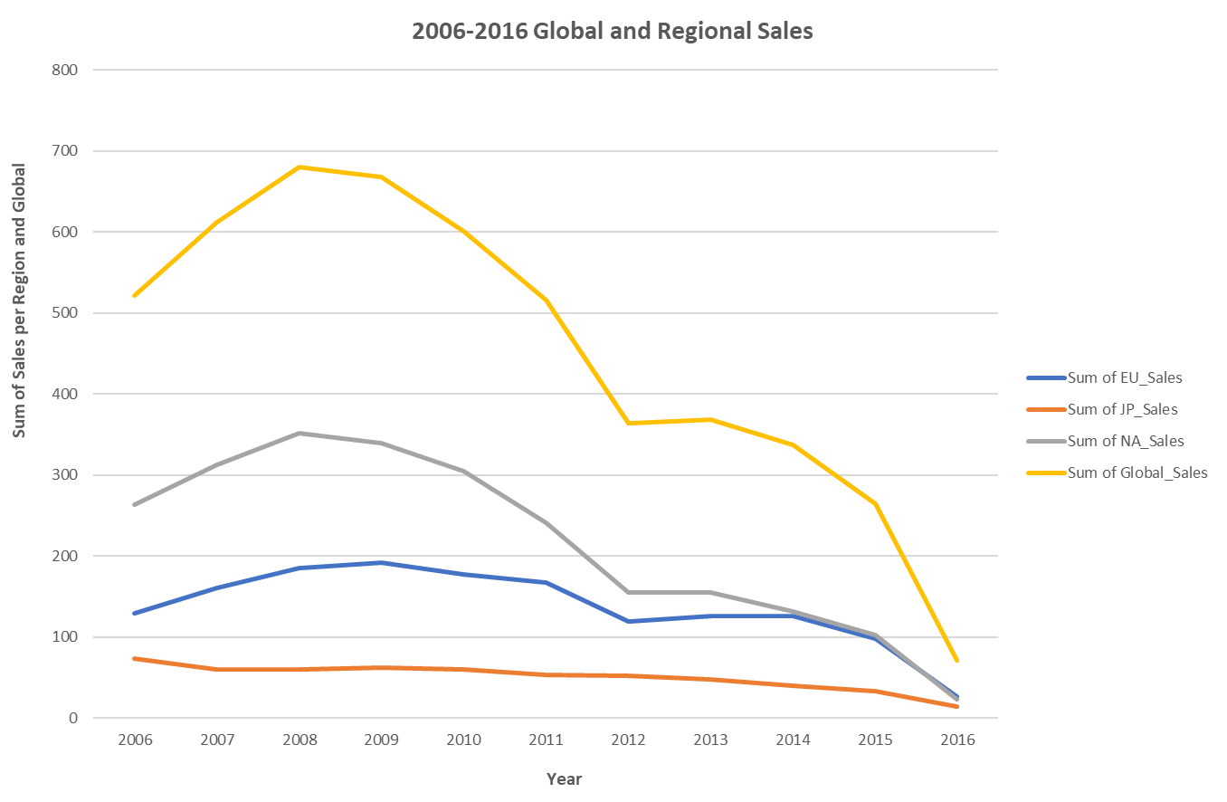

Slide 4

Sales Recap:
Since 2008 the sales on a global level have steadily decreased.
NA sales are steadily decreasing and EU sales have caught NA sales.
JP sales are trending down as well although they are the most consistent of all sales.

Slide 5

Publisher Insights
Looking at the top Publishers by Genre may help scale back the number of Publishers to focus on.
Roughly 72% of the sales are done on the 30 Publishers shown in the following graphs.
Cross referencing the highest sales by Publisher and the top sales by genre shows us where to focus marketing and development in specific regions and later on certain platforms.
There are a lot of Publishers with very little sales so narrowing which publishers are performing will also save resources and money.

Slide 6
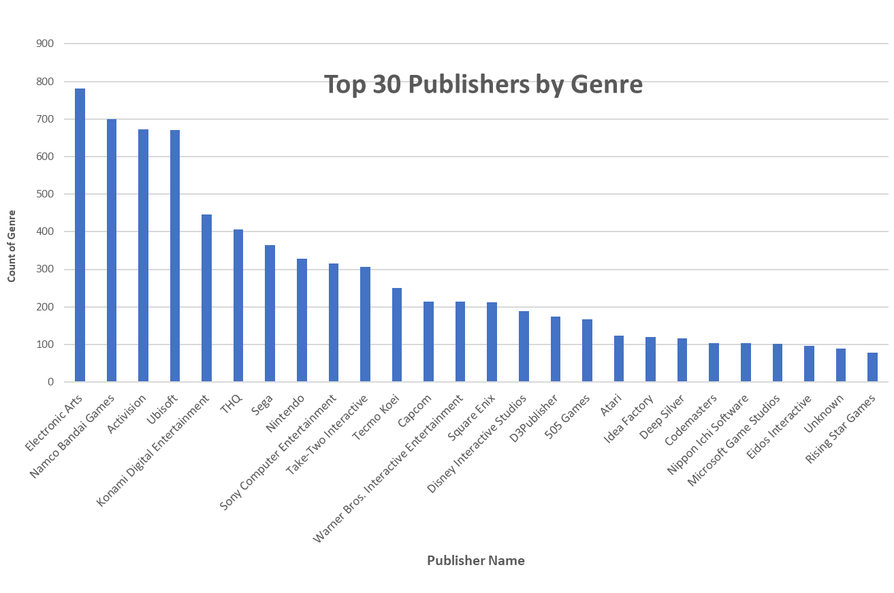

Slide 7

Genre Recap
Action games are the highest sellers in both the EU and NA Sales
Role Playing is the largest seller in JP sales of all Genres
Looking into what is categorized as Misc. may help drive sales in all markets this is a rather large genre overall for sales

Slide 8
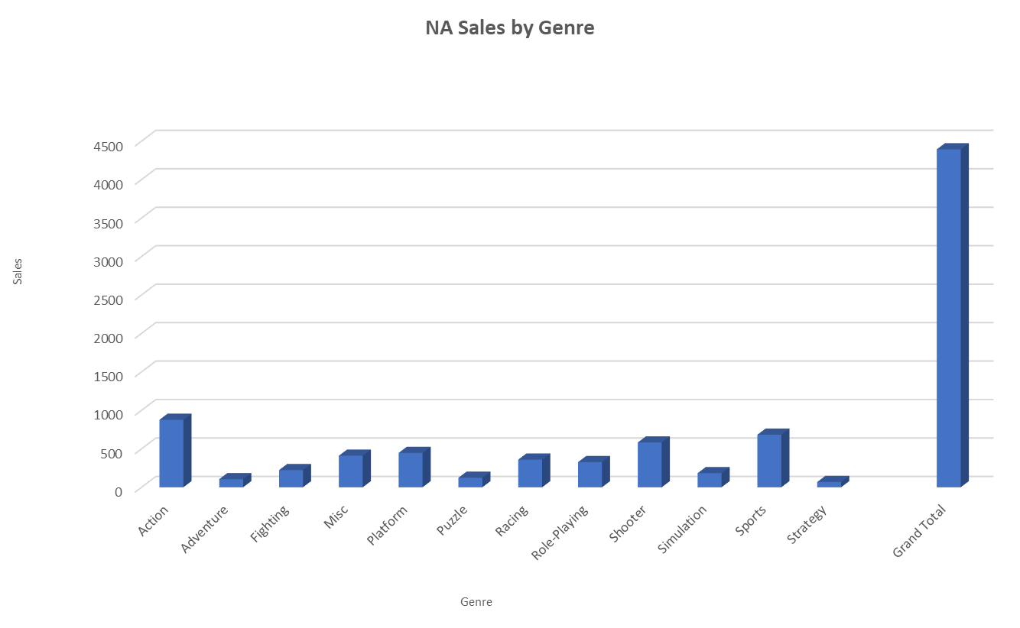

Slide 9

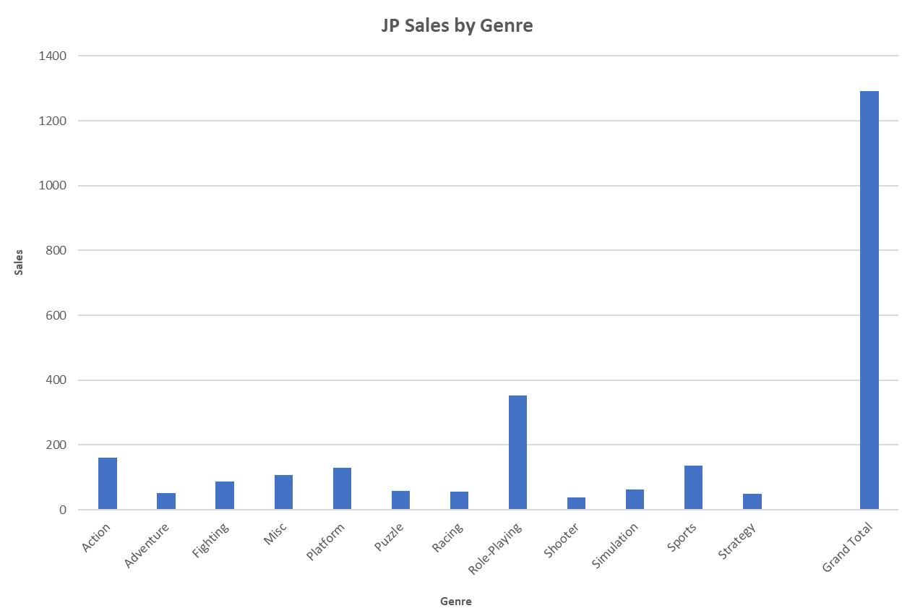

Slide 10

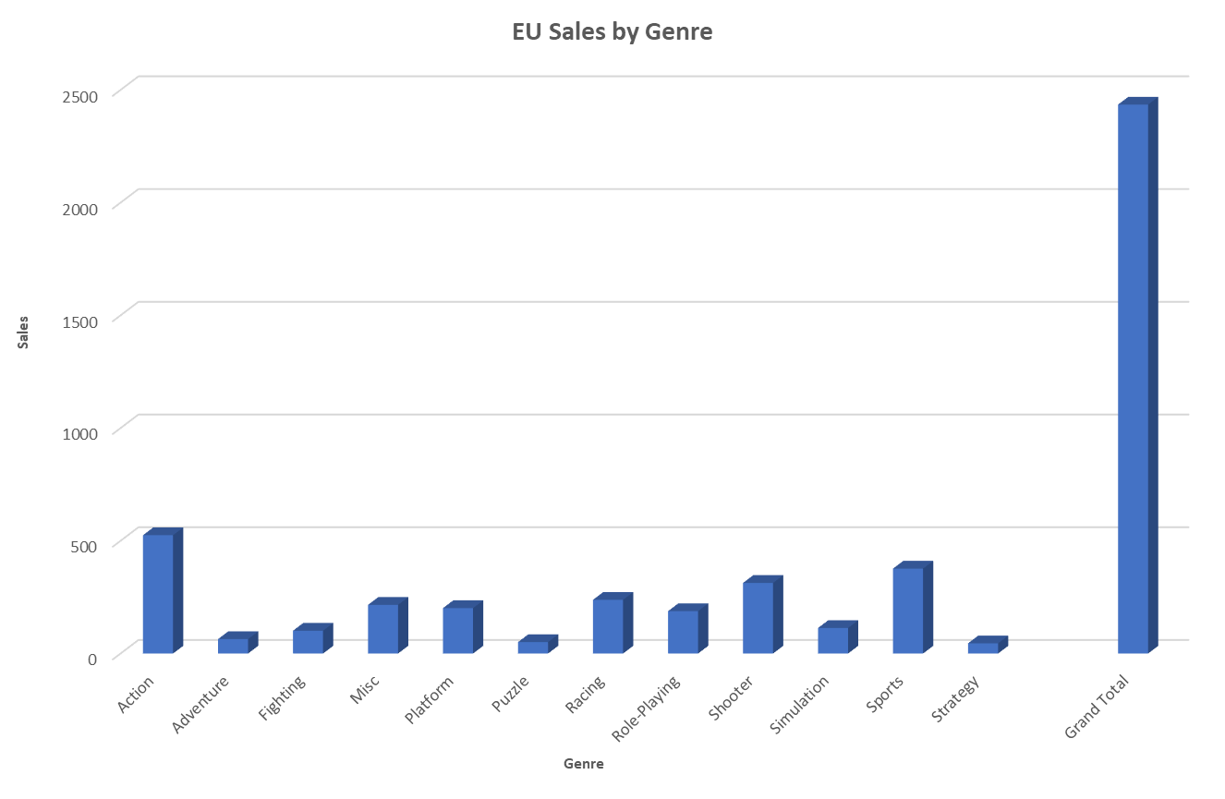

Slide 11

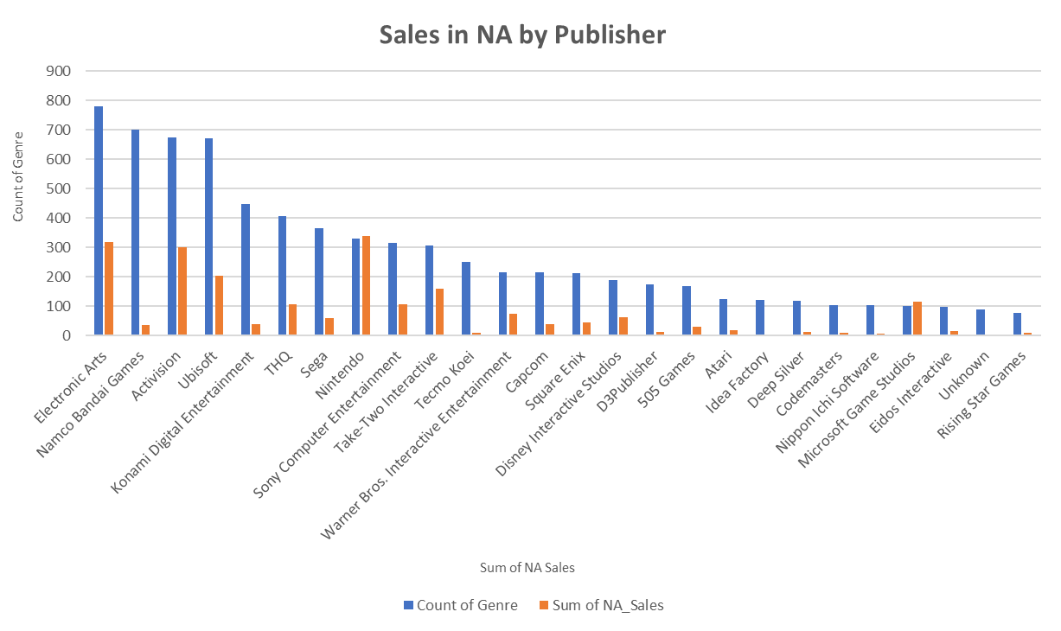

Slide 12

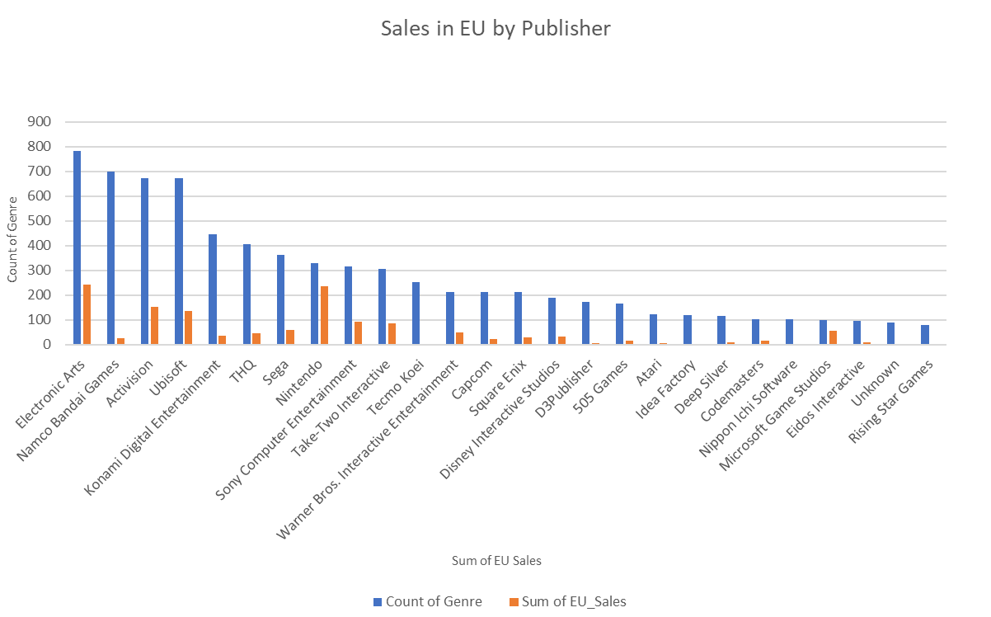

Slide 13

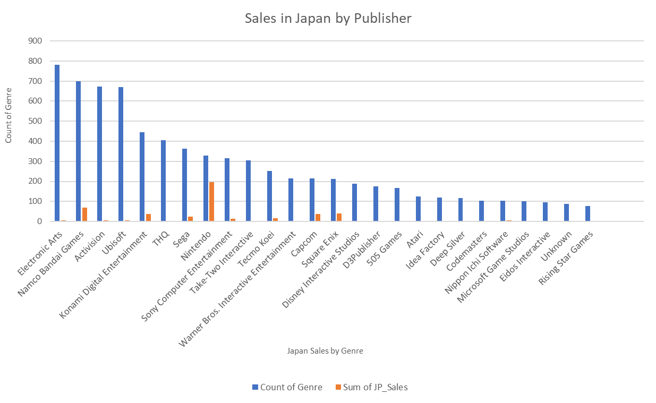

Slide 14
Publisher Insights
The same Publishers seem to track the highest sales in all regions.
Further comparisons of Publishers and Genres will be helpful.
Nintendo sales do well in all regions – especially Japan – so as we focus on growth in that market that is one publisher to focus on.

Slide 15
Conclusions:
Sales have been trending down for all data the past 10 years. North America has the highest sales with Europe following, and Japan a very distant third. There are huge differences in sales by Genre and also by platform.
Recommendations:
Marketing should look at the top three genres by regional sales and focus on sales growth there. Example: Japan sales are largest in role playing how many platforms is that genre being offered on and how can we expand sales in that area.
An in depth look at what the Miscellaneous genre includes should be completed as this is in the top 5 for sales in all Regions and it may be an opportunity to drive sales in all regions.
With decreasing sales are we wasting resources having so many platforms when many are outperforming by genre? Is this possibly why sales are decreasing are we not focusing on expanding a specific platform and loosing market share?

